Slide 1
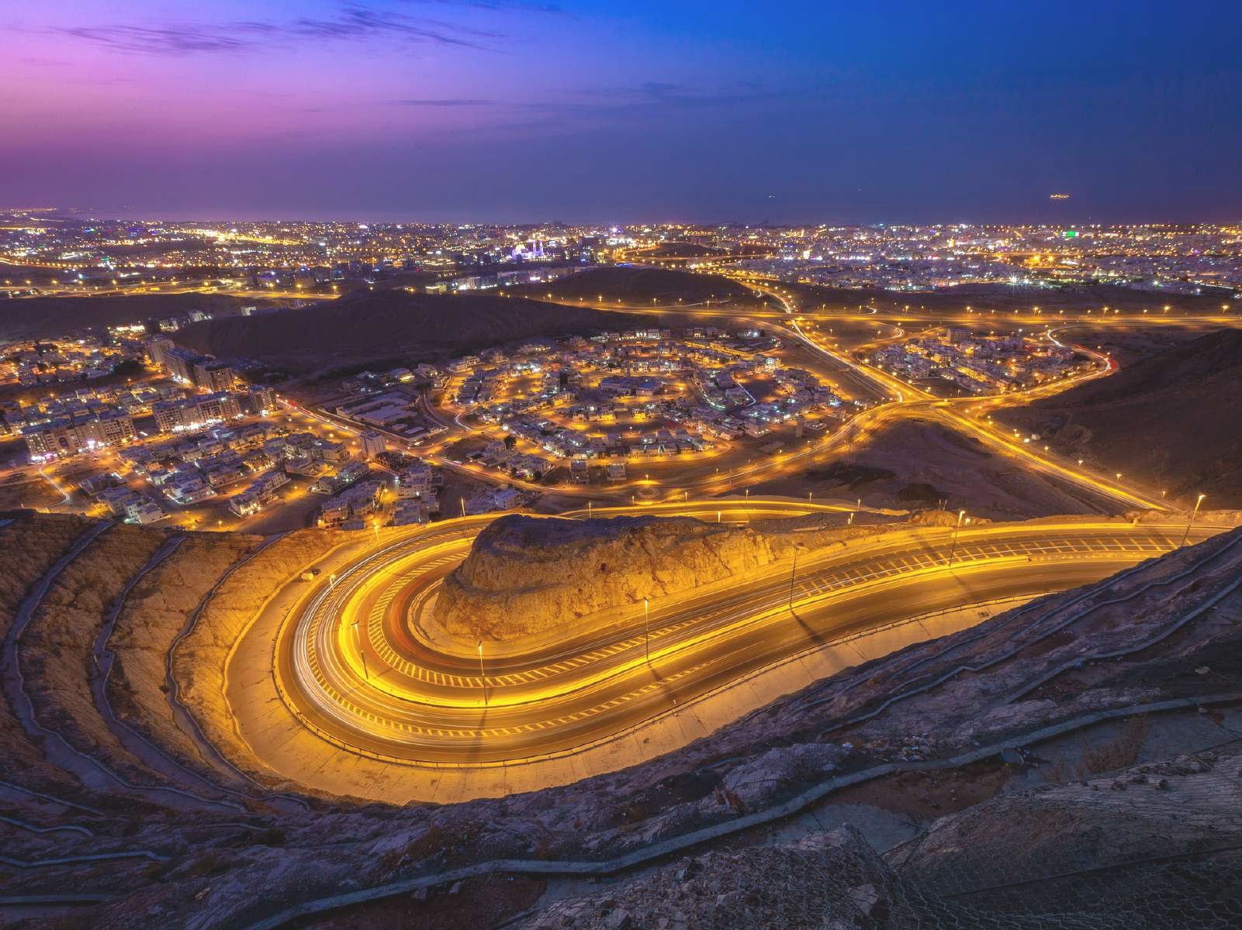
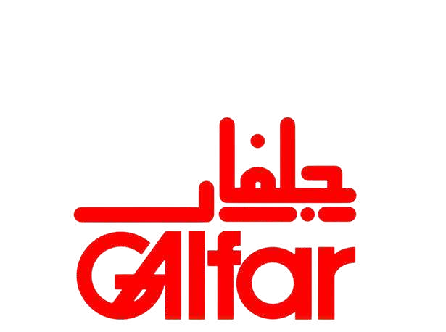
Trusted Partner in Development
GALFAR ENGINEERING & CONTRACTING SAOG

Slide 2
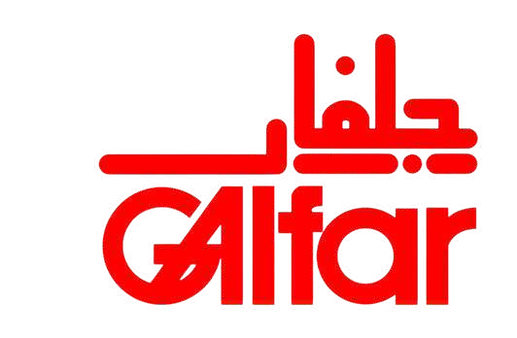







Galfar at a Glance
Award Winning & Strong Brand Value
Partner in Oman Renaissance Since 1972
Wide Assets Base & Infrastructure Presence Around Oman
Availability of More Than 4000 Plants and
Machineries
Constructed Over 4000 Km of Roads
Laid Over 8000 Km Pipelines / Flowlines
Delivered Over 1000 Projects in Excess of 10 Billion USD
Achieved Annual Turnover of 1 Billion USD
ICV,Rich with More Than 3500 National Employees
Galfar Engineering & Contracting SAOG was established in 1972 and has since grown to be among the largest publicly listed companies in Oman and one of the largest construction companies in the Middle East.
Largest Listed Company in Muscat Exchange Market with 4000 Shareholders
Enabler to the Local Supply chain, with Over 1500 Registered Local Vendors
Leader in Employing & Developing Omanis in the Construction Industry
03

Slide 3
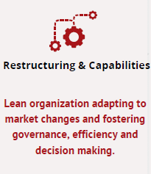
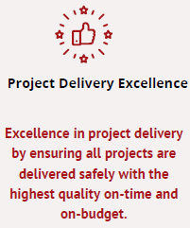
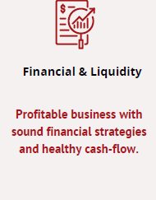
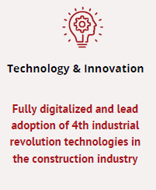
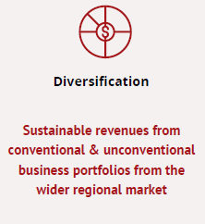
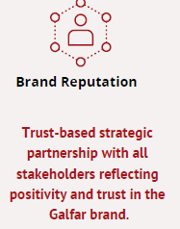
Vision & Strategic Plan
Six Strategic Priorities
Vision
To be the market preferred and trusted partner in development creating sustainable value-based growth to our stakeholders
Mission
World class performance in project delivery
Innovation in project management & execution
Maximization of our customer value
08

Slide 4
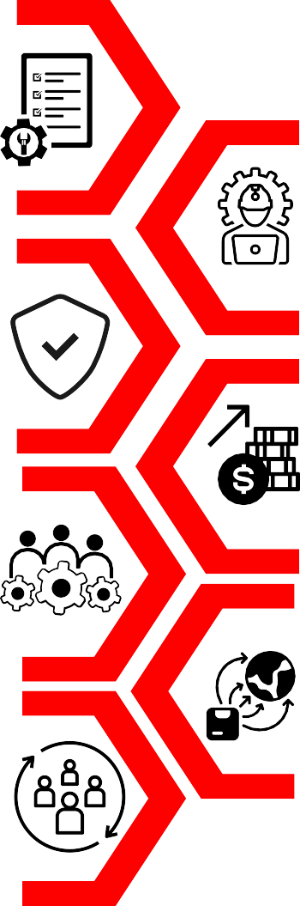
Core Strengths
Strong Corporate Governance empowered by adhering to listed Companies and Governance Rules.
Valuable Projects lesson learnt database, fit for purpose processes, state of art software & digitization.
Highest Quality and Safety standards & records.
Access to local and international finance facility.
Experienced large base of Manpower & diverse fleet of equipment’s and machinery.
Wide access to the local supply chain and outreach to regional and global supply networks.
Socially responsible and In Country value (ICV) rich organization.
08

Slide 5
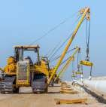
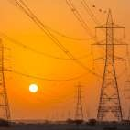

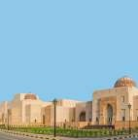
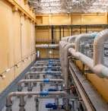
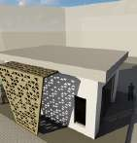
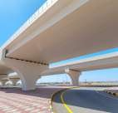
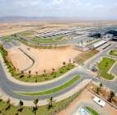
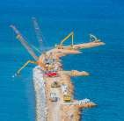
Business Portfolios
Energy
& Industry
Civil
& Environment
Subsidiaries &
Associates
Infra-structure
02

Slide 6
Turnover Forecast
COVID-19 Pandemic
The company is planning to maintain annual turnover above RO 200M ($ 520M)
To be sustained through:
Significant order book of jobs in-hand >RO 500M ($ 1.3B)
Identified addressable market in excess of RO 2.0B annually for 2022 - 2024
02

Slide 7
Growth Through Diversification
Conventional Contracting / Construction Projects
Diversification Streams
Oil & Gas EPC, DBOOM
Renewables
PPP (Ports, Roads, Civil, Environment)
Technology & Innovation
Regional Markets
02

Slide 8
Market Share Price
2020
4 X
2022
02

Slide 9
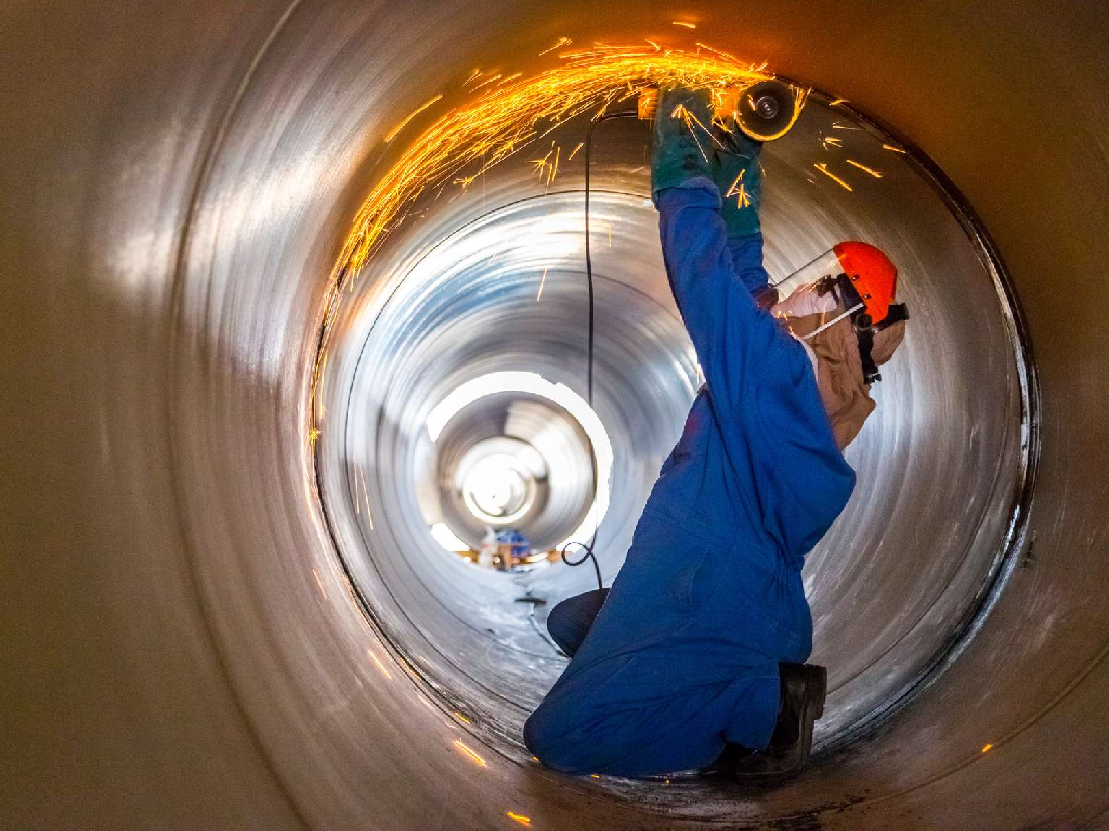
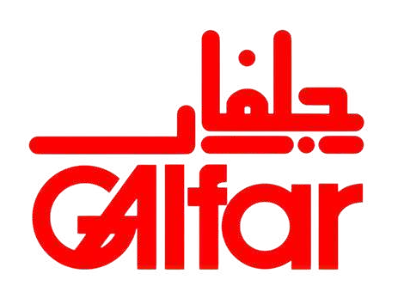
Thank You

